Slide 1
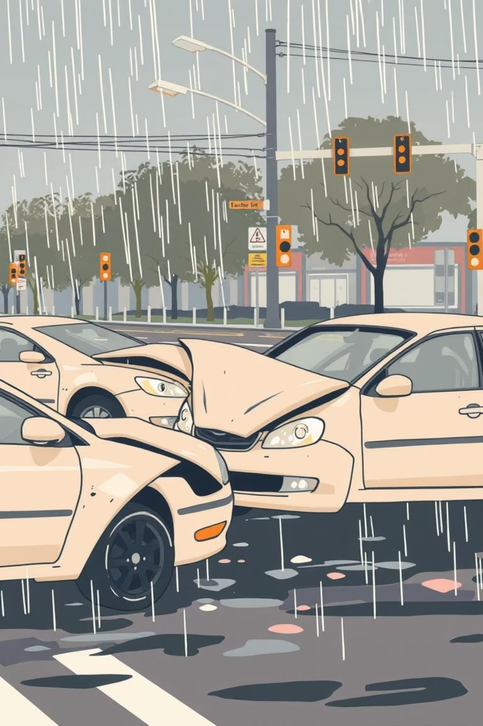

Traffic Accident Severity: The Accuracy Paradox
Why 84% Accuracy is Misleading in Safety-Critical Models
This presentation delves into the critical challenge of accurately predicting traffic accident severity. We explore why a seemingly high accuracy score can be deceptive in safety-critical applications, particularly when dealing with imbalanced datasets, and how traditional metrics can lead to models that are practically useless in real-world scenarios.

Slide 2
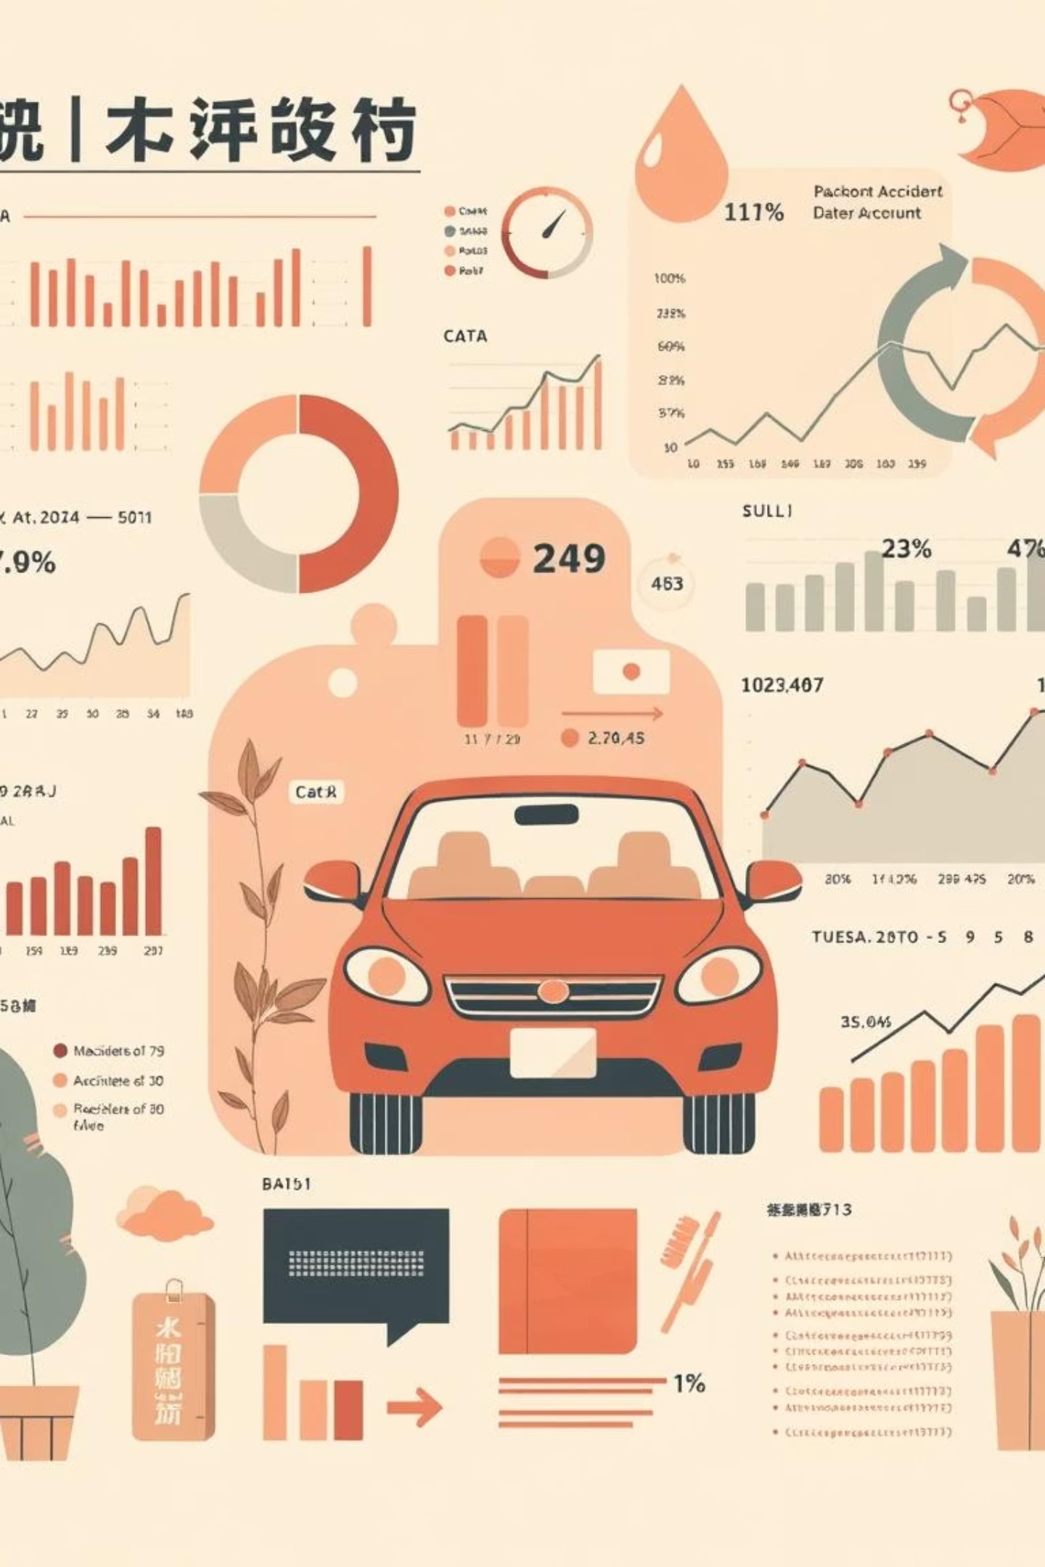
Predicting Traffic Accident Severity
Objective
Dataset Overview
Our primary goal is to predict whether a traffic accident will be classified as Minor, Moderate, or Severe. This prediction is crucial for proactive safety measures and resource allocation.
We utilized a comprehensive dataset comprising 209,306 accident records, each enriched with 24 distinct features. These features span environmental conditions like Weather, infrastructure issues such as Road Defects, and visibility factors like Lighting.
The Core Challenge
The most significant hurdle encountered was the extreme class imbalance within the dataset. A vast majority of recorded incidents are "Minor" accidents, making it inherently difficult for predictive models to effectively learn and identify the rarer "Severe" accident patterns.

Slide 3

Preparing the Data for Analysis
Robust data preprocessing is the foundation for any successful predictive model. Our meticulous approach ensured that the data was clean, relevant, and optimally formatted for machine learning algorithms.
Data Transformation
Data Cleaning
To prepare the data for various model types, we applied One-Hot Encoding for all categorical variables, converting them into a numerical format suitable for algorithms. For numerical features, StandardScaler was used to normalize their ranges, preventing features with larger values from dominating the learning process.
Feature Engineering
A crucial step involved removing columns that could introduce data leakage, preventing the model from inadvertently using future information. Additionally, we implemented strategies to handle and impute missing values, ensuring data integrity.
We extracted critical temporal features such as Hour, Day, and Month directly from the raw crash timestamps. This allowed the model to capture time-dependent patterns and cyclical trends in accident occurrences.

Slide 4

The "Accuracy Trap": High Accuracy, Low Utility
Initial evaluations using traditional machine learning models revealed a common pitfall in imbalanced datasets: models achieving high overall accuracy while failing to address the critical minority classes.
Baseline Model Performance
Logistic Regression
67%
Random Forest
82%
XGBoost
84%
The Problem with XGBoost (84% Accuracy)
Despite achieving an impressive 84% accuracy, the XGBoost model catastrophically failed to predict "Severe" accidents, registering an F1-Score of a mere 0.02.
This highlights a critical issue: the model optimized for overall accuracy by predominantly classifying incidents as "Minor." In a safety-critical context, a model that ignores severe events is not just ineffective but potentially dangerous.
A high accuracy score can be profoundly misleading when rare, yet critical, outcomes are overlooked.

Slide 5
Deep Learning Approach: Implementing Neural Networks (ResNet)
Seeking to capture more complex patterns and potentially overcome the limitations of classical models, we transitioned to a deep learning approach, utilizing a ResNet architecture.
Model Architecture
Initial ResNet Results
The Persistent Issue
We employed a sophisticated Neural Network incorporating ResNet blocks. These blocks are renowned for their ability to learn intricate hierarchical features and mitigate the vanishing gradient problem in deep networks, making them suitable for capturing nuanced patterns in accident data.
The initial ResNet model mirrored the challenge faced by XGBoost. While achieving a global accuracy of approximately 84%, it continued to largely ignore the minority classes—"Moderate" and "Severe"—in its predictions, prioritizing overall accuracy.
This behavior, consistent across both classical and initial deep learning models, underscores the profound impact of class imbalance. Maximizing global accuracy without explicit intervention leads to models that are excellent at predicting the frequent "Minor" class but blind to critical rare events.

Slide 6



The Solution: Handling Imbalance
Prioritizing Safety Over Raw Accuracy
To compel the model to effectively learn and predict "Severe" cases, we implemented advanced techniques specifically designed to mitigate the effects of extreme class imbalance. This shift in strategy prioritized the accurate identification of critical events over a misleading overall accuracy.
Class Weights
Oversampling
Weighted ResNet Architecture
We introduced class weights during model training. This technique assigns a higher penalty to misclassifications of "Severe" and "Moderate" accidents, effectively forcing the model to pay more attention to these rare but critical events.
To provide the model with more examples of underrepresented classes, we utilized oversampling techniques. This artificially increased the number of "Severe" and "Moderate" accident examples in the training data, allowing the model to learn their patterns more effectively.
Building on the ResNet foundation, we developed a specialized Weighted ResNet architecture. This design inherently incorporates mechanisms to handle imbalanced data, ensuring that the model's internal learning processes are biased towards the identification of critical classes.

Slide 7
The Real-World Result
The Trade-off: Accuracy vs. Recall
The implementation of imbalance handling techniques led to a significant paradigm shift in our model's performance, prioritizing the detection of critical events over a simplistic accuracy metric.
70.75%
Significant Increase
New Accuracy
Severe Accident Detection
The overall accuracy of our Weighted ResNet model decreased to 70.75% from the initial 84%. This deliberate trade-off reflects the model's new focus on critical classifications.
Crucially, the model's ability to detect dangerous accidents improved significantly. While the raw accuracy dropped, the recall for severe cases dramatically increased, demonstrating a more valuable and safer predictive capability.
Conclusion: Safety-Critical AI
In the realm of safety-critical AI, a 70% accurate model that reliably catches severe crashes is unequivocally superior to an 84% accurate model that effectively ignores them. Prioritizing recall for critical events is paramount.

Slide 8
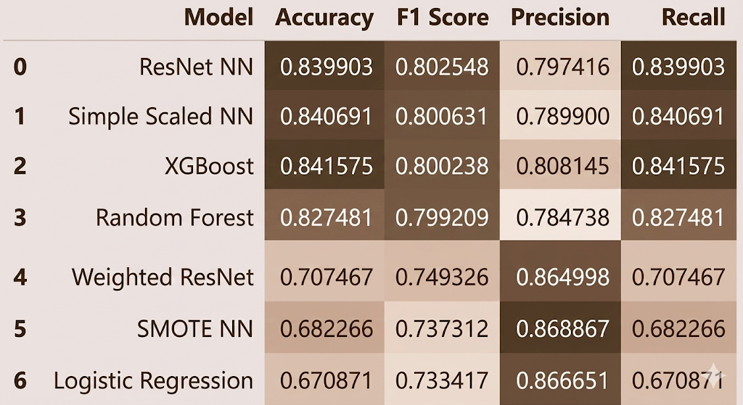


Slide 9
The Importance of Context in Model Evaluation
Beyond raw numbers, understanding the context and implications of model performance is vital, especially when lives are at stake. This insight is key for data scientists and safety engineers.
Beyond Accuracy
Cost of Error
Ethical AI
While accuracy is often the go-to metric, for imbalanced datasets and safety-critical applications, it can be a misleading indicator. Metrics like recall, precision, and F1-score for each class provide a more nuanced and honest picture of a model's true utility.
The cost of a false negative (failing to predict a severe accident) is astronomically higher than the cost of a false positive (predicting a severe accident that turns out to be minor). Model evaluation must reflect these real-world consequences.
Developing ethical AI in safety contexts means building models that are fair, transparent, and prioritize the prevention of harm over statistical optimization for benign outcomes. It requires a human-centric approach to metric selection.

Slide 10




Future Recommendations
Next Steps for Continuous Improvement
To further enhance the robustness and real-world applicability of our accident severity prediction model, we propose several key areas for future development.
Enhanced Data Collection
Feature Expansion
Prioritize gathering more real-world data specifically for "Severe" crashes. Reducing reliance on synthetic oversampling will lead to more robust and generalizable model performance.
Explore the integration of advanced telematics data or speed sensor data from vehicles involved in accidents. These features could provide granular insights into crash dynamics, significantly improving predictive accuracy for severe events.
Continuous Learning Loops
Model Deployment
Implement a feedback loop where new accident data continuously retrains and refines the model, ensuring it adapts to changing conditions and maintains optimal performance over time.
Deploy the Weighted ResNet model as a crucial component of an alert system. This system could identify high-risk conditions in real-time, enabling rapid response and potentially preventing severe outcomes.

Slide 11

The Path Forward: From Prediction to Prevention
Building Safer Roads with Intelligent Models
Our journey through the Traffic Accident Severity project underscores a fundamental principle in safety-critical AI: the true measure of a model's success lies not in its overall accuracy, but in its ability to reliably identify and respond to the most critical, yet rare, events.
Redefining Success
Moving beyond misleading accuracy metrics to focus on comprehensive evaluation that prioritizes critical event recall.
Ethical Data Science
Committing to ethical AI development that ensures models contribute positively to public safety and well-being.
Collaborative Innovation
Fostering collaboration between data scientists, engineers, and policymakers to integrate advanced predictive models into real-world safety initiatives.
By embracing these principles, we can transform predictive analytics from a statistical exercise into a powerful tool for preventing tragedies and building safer transportation systems for everyone.

